Slide 1
BIFX 503: Statistics for Bioinformatics
Instructor: Jennifer Schroeder, Ph.D.
Wednesdays, 5:30-8:00pm
Hodson Technology Center, Room 237
Fall 2021

Slide 2
Association and Independence

Slide 3
Association and Independence
Association between two continuous variables
Correlation
Association between two categorical variables
Chi square test
Fisher’s exact test
Association between a continuous variable and a categorical variable
T test (2 categories) – last week
ANOVA (3+ categories) – next week

Slide 4
Correlation

Slide 5
Scatterplot
Plot of two quantitative variables
Shows the relationship between them
X is called the explanatory or predictor variable
Y is called the response variable

Slide 6
Characteristics of Scatterplots
Direction: negative or positive?
Form: linear or other?
Strength of association: strong or weak?
Unusual features: outliers or clusters?

Slide 7


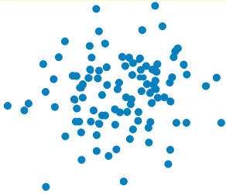
Direction of Association
Positive
Negative
None (independence)

Slide 8


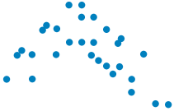
Form
Linear
Curved

Slide 9


Strength of the Relationship
Strong linear relationship
Moderate linear relationship
No linear relationship (independence)

Slide 10
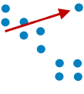
Unusual Features
Outliers or “clumps” of data
Outliers should be investigated as possible errors
Clusters can indicate subgroups in your sample

Slide 11
Creating a Scatterplot in R
plot() function
Specify:
x and y variables, may use formula notation
type of plot (scatter plot is default)
point type, size, color
x and y axis scaling
titles and axis labels

Slide 12
Review: Basic Plotting Syntax
Graphical parameters
pch: the plotting symbol (default is open circle)
cex: size of plotting symbol (scaled relative to default)
col: plotting color
xlim, ylim: axis limits
xlab, ylab: axis labels

Slide 13
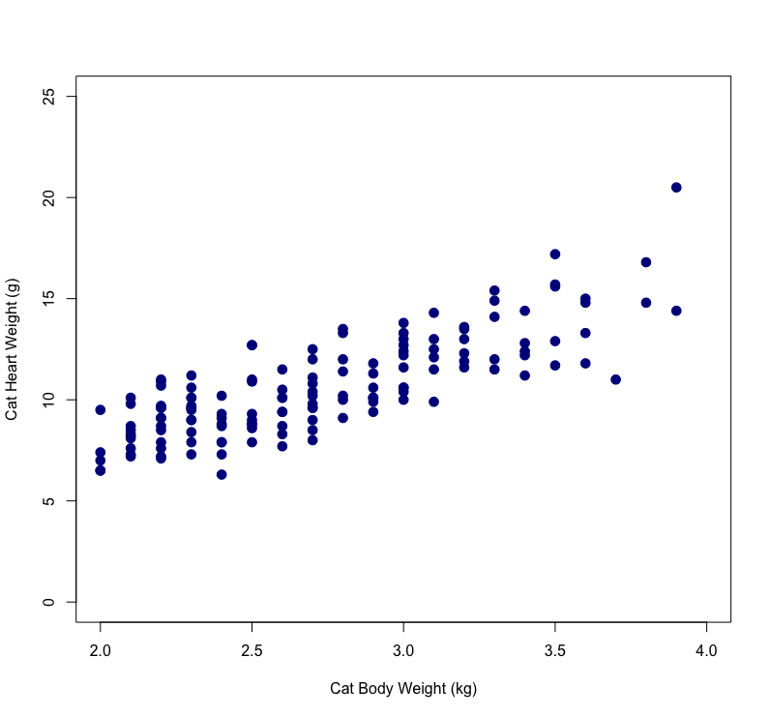
Scatterplot Example
Cat body weight (kg) and heart weight (g)
plot(cats$Bwt, cats$Hwt, xlim=c(2, 4), ylim=c(0, 25), pch=20, cex=2, col="darkblue", xlab="Cat Body Weight (kg)", ylab="Cat Heart Weight (g)")

Slide 14
Alternative: ggplot
“grammar of graphics”
Data visualization package based on components or “layers”
“geom” identifies type of graph (scatterplot, line plot, etc.)
Different layers for axis labels, title, colors, panel plot, …
Layers specified by functions strung together by “+”

Slide 15
Basic Scatterplot in ggplot
ggplot(cats, aes(x=Bwt, y=Hwt)) + geom_point() + xlab("Cat Body Weight (kg)") + ylab("Cat Heart Weight (g)")

Slide 16
Scatterplot in ggplot
ggplot(cats, aes(x=Bwt, y=Hwt, color=Sex)) + geom_point() + xlab("Cat Body Weight (kg)") + ylab("Cat Heart Weight (g)")

Slide 17
Scatterplot in ggplot
ggplot(cats, aes(x=Bwt, y=Hwt)) + geom_point() + facet_grid(. ~ Sex) + xlab("Cat Body Weight (kg)") + ylab("Cat Heart Weight (g)")

Slide 18
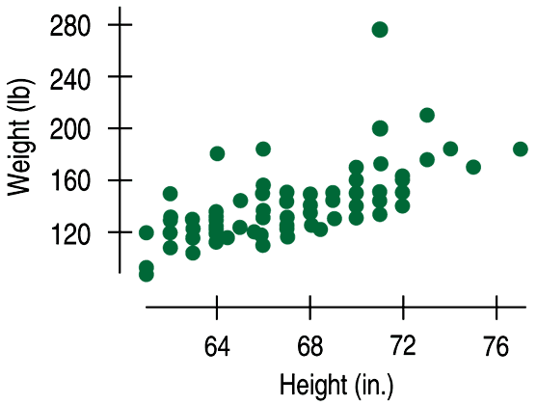
Correlation
The correlation coefficient gives us a way to quantify the linear association we see in a scatterplot

Slide 19
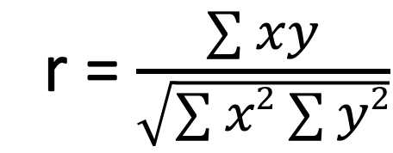
Correlation Coefficient
The correlation coefficient (r) gives us a numeric representation of the strength of linear relationship between two variables
Magnitude does not depend on the units of measurement for x and y
r = $\frac{\sum{xy}}{\sqrt{\sum{x2}\sum{y2}}}$

Slide 20
Conditions for Correlation
Both variables must be quantitative and normally distributed
The relationship between them must be linear
Make scatterplot first to check
Does the pattern of points look like a reasonably straight line?
There should be no strong outliers
Outliers can affect (bias) the correlation

Slide 21
Interpreting Correlation
r > 0 → positive linear association
r < 0 → negative linear association
−1 < r < 1
r = − 1 only if the points all lie exactly on a negatively sloped line
r = 1 only if the points all lie exactly on a positively sloped line
Interchanging x and y does not change the correlation.
r has no units
Changing the units of X or Y does not change r

Slide 22
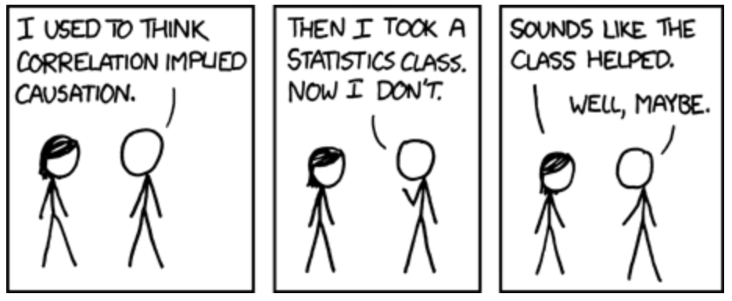
Correlation ≠ Causation
Image credit https://imgs.xkcd.com/comics/correlation.png

Slide 23
Correlation ≠ Causation
A high correlation between X and Y doesn’t mean that X caused Y
Y could have caused X
A third variable may explain the association
Gray hair and wrinkles are strongly correlated but dyeing hair does not make wrinkles disappear!
A third variable (age) causes both of them

Slide 24
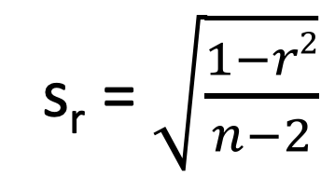
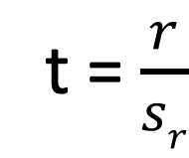
Hypothesis Testing: Correlation
Frequently we want to objectively determine if the correlation is different from zero (no association between x and y, independence)
H₀: ⍴ = 0 vs. H_{A}: ⍴ ≠ 0
We do this using the t distribution:
t = $\frac{r}{sr}$
s_{r} = $\sqrt{\frac{1−r2}{n−2}}$
Where the standard error of r is:
Degrees of freedom (df) = n-2

Slide 25
Correlation in R
cor(xvar, yvar)
Calculates correlation coefficient
cor.test(xvar, yvar, conf.level = 0.95)
Calculates correlation coefficient and confidence interval
Can specify % confidence, 95% is default
Performs t test to see if differs from zero
Can limit to a subset of data using subset argument
e.g. subset = sex == “F”

Slide 26
Correlation in R
Correlation can only be calculated on complete data (no missing values)
Missing values will cause the resulting correlation coefficient to be NA
If your data contain missing values, you must tell R to ignore them
cor( … , na.rm = TRUE)
cor.test( ... , na.action=”na.exclude”)

Slide 27
Correlation in R
cor.test( …. , method=“spearman”)
Calculates Spearman’s correlation coefficient
Like Pearson’s only based on ranks instead of measured values
Nonparametric, not biased by outliers
cor.test( …, alternative = “less”)
Or “greater”
Allows one-sided hypothesis testing

Slide 28
Correlation in R
Alternate syntax: formula
cor.test( ~ xvar + yvar, data)
Can limit to a subset of data using subset argument
e.g. subset = sex == “F”

Slide 29
Example: Cat Anatomy
Body weight (kg) and heart weight (g) measured in 144 domestic cats
Evaluate the association between these two quantities:
Visualize the relationship using a scatterplot
Calculate the Pearson correlation coefficient
Test the hypothesis that r = 0
Calculate a 95% confidence interval for the correlation coefficient
Do the correlations differ by sex?

Slide 30
Class Exercise #1
Data: trees
For each pair of variables:
Make a scatterplot to visualize the relationship
Calculate the correlation coefficient and 95% confidence interval, and test the hypothesis that the correlation is unequal to zero
Do the correlation coefficients agree with your observations about the data?

Slide 31
Correlation Visualization 1: Scatterplot Matrix
Base R function pairs(df[,col_{1st}:col_{last}])
pairs(iris[,1:4])
pairs(trees)

Slide 32
Correlation Visualization 2: Heat Maps
A heat map is a valuable tool for visualizing associations between variables
It can be helpful to visualize large correlation matrices
Correlations are color-coded

Slide 33
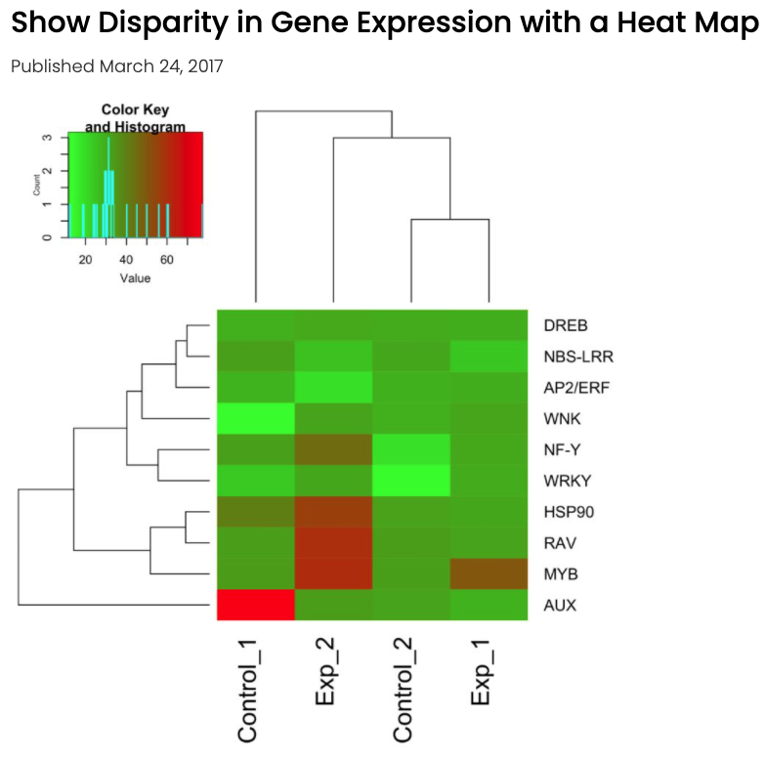
Heat Map of Gene Expression
Image credit https://bitesizebio.com/34121/show-disparity-gene-expression-heat-map/

Slide 34
Heat Maps in R
A basic heat map can be generated using the heatmap() function
Syntax: heatmap(data)
Optional arguments include:
Symmetry (for square matrix)
Axis labels, margins
Color scheme

Slide 35
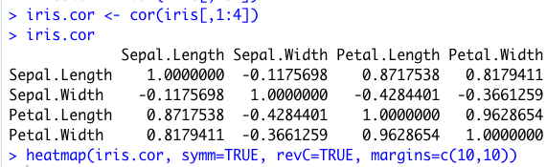
Heat Maps in R
Heat map to visualize correlation matrix of iris data

Slide 36
Heat Maps in R
Default color scheme if none specified
Others (specify with col= )
rainbow(256)
cm.colors(256)
terrain.colors(256)
topo.colors(256)
Specialty packages provide more control over the appearance of the heatmap
Heatmap.2
RColorBrewer

Slide 37
Advanced Visualizations of Correlation
function ggcorrplot()
Heatmaps with other options
Correlation value/significance
ggcorrplot(iris.cor, method=“circle”)

Slide 38
Contingency Tables

Slide 39
Tables in R - Univariate
table(data$x)
Frequency counts for values of x
prop.table(table(data$x))
Proportions for values of x

Slide 40
Tables in R - Bivariate
table(data$x, data$y)
Cross-tabulated frequency counts for values of x (row variable) and y (column variable)
prop.table(table(data$x, data$y), 1)
Cross-tabulated proportions by row
prop.table(table(data$x, data$y), 2)
Cross-tabulated proportions by column

Slide 41
Example dataset
Dataset birthwt from the MASS package
Risk factors associated with low infant birth weight
Variables
low = low birth weight (<2.5 kg)
age = mother’s age in years
lwt = mother’s weight at last menstrual period
race = mother’s race (1=white, 2=black, 3=other)
smoke = smoked during pregnancy
ptl = number of premature labors
ht = history of hypertension
ui = uterine irritability
ftv = number of physician visits during 1st trimester

Slide 42
Class Exercise #2
Create the following tables:
Univariate frequency counts and proportions for all categorical variables in the dataset
Bivariate frequency counts for the ”low” variable cross-tabulated with all other categorical variables in the dataset
Tables that compare the proportions of the following variables for low birthweight vs normal birthweight babies:
Race, smoking, number of premature labors, history of hypertension, number of physician visits during first trimester

Slide 43
Contingency Table
A table that shows the frequency counts for two categorical variables
P(Rain in Forecast) = 90/365 = 24.65%
P(Forecast Correct) = (27+268)/365 = 80.82%
P(No Rain) = 331/365 = 90.68%
 |  | Actual Weather
Forecast |  | Rain | No Rain | Total
 | Rain | 27 | 63 | 90
 | No Rain | 7 | 268 | 275
 | Total | 34 | 331 | 365

Slide 44
Conditional Probability
Conditional probability is the probability of an outcome, given that a condition is met
The probability that it rained, given that rain was in the forecast:
P(rain | rain forecast) = 27/90 = 0.30
 |  | Actual Weather
Forecast |  | Rain | No Rain | Total
 | Rain | 27 | 63 | 90
 | No Rain | 7 | 268 | 275
 | Total | 34 | 331 | 365

Slide 45
Independence
Events A and B are independent if A happening does not change the probability of B, and vice versa
If A and B are independent:
P(B|A) = P(B)
P(A|B) = P(A)
P(A and B) = P(A) x P(B)

Slide 46
Assessing Independence
 |  | Actual Weather
Forecast |  | Rain | No Rain | Total
 | Rain | 27 | 63 | 90
 | No Rain | 7 | 268 | 275
 | Total | 34 | 331 | 365
P(rain | rain forecast) = 27/90 = 0.30
P(rain) = 34/365 = 0.093
P(rain | rain forecast) ≠ P(rain)
Not Independent
Note: Weak evidence; not a formal hypothesis test

Slide 47
Chi-Square Tests
Goodness-of-Fit
Compare observed frequency counts with what would be expected under a theoretical model
Homogeneity
Compare observed frequency counts in one group with those in another group
Independence
Determine whether frequencies of two variables measured in the same sample are independent

Slide 48
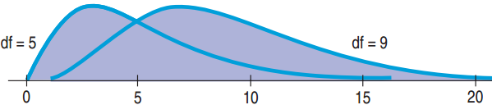
Probability Model: Chi-square
Unimodal but not symmetric
Indexed by degrees of freedom

Slide 49
Chi-Square Statistic
Based on comparing the frequencies you observe in your data with what you would expect if the null hypothesis (no association) were true:
The greater the difference between observed and expected, more likely to reject H₀

Slide 50
Example: Goodness of Fit Test
Four seed phenotypes
Test the hypothesis that this sample comes from a population having a 9:3:3:1 ratio of yellow smooth to yellow wrinkled to green smooth to green wrinkled, based on the data in the table below
Yellow Smooth | Yellow Wrinkled | Green Smooth | Green Wrinkled | Total
152 | 39 | 53 | 6 | 250

Slide 51
Example: Homogeneity
Test the hypothesis that the proportions of males and females are the same among individuals having each hair color
H₀: p₁ = p₂ = p₃ = p₄
H_{A}: the proportions are not all the same
 | Black | Brown | Blonde | Red | Total
Male | 32 | 43 | 16 | 9 | 100
Female | 55 | 65 | 64 | 16 | 200
Total | 87 | 108 | 80 | 25 | 300

Slide 52
Example: Independence
Test the hypothesis that gender and hair color are independent
H₀: Hair color is independent of sex in the population sampled
H_{A}: Hair color is not independent of sex in the population sampled
 | Black | Brown | Blonde | Red | Total
Male | 32 | 43 | 16 | 9 | 100
Female | 55 | 65 | 64 | 16 | 200
Total | 87 | 108 | 80 | 25 | 300

Slide 53
Chi Square Tests: Assumptions
Both variables are categorical
Each sampling unit contributes to only one cell in the table
The expected frequency in each cell is at least 5 (for 2x2 tables)

Slide 54
Chi Square Tests in R
chisq.test(table(data$x, data$y))
Example:
chisq.test(table(birthwt$low, birthwt$smoke))

Slide 55
Fishers’ Exact Test
The Chi-square test is valid for larger samples
An alternative test, Fisher’s Exact Test, is to be used when the expected frequency count in any cell is less than 5
Many statistical software programs will tell you if you use a Chi-square test when Fisher’s Exact should be used instead ☺

Slide 56
Fisher’s Exact Test in R
fisher.test(table(data$x, data$y))
Example:
fisher.test(table(birthwt$low, birthwt$ht))

Slide 57
Class Exercise #3
Use both chi square and Fisher’s exact test to determine if low birth weight is associated with each of the following:
Smoking, pre-term labor, hypertension, and number of physician visits during the first trimester
Now test the same hypotheses using the chi square test
Do the results agree?

